Slide 1


Alternate Feature Selection Methods for Logistic Regression
Wake Forest
School of Business
_______
BAN 6025

Slide 2
Feature Selection
When you have too many variables in your model, it can lead to issues with
Multicollinearity
Overfitting
Unnecessary complexity, difficulty of interpretation
The curse of dimensionality: including more input variables does not necessarily improve the quality of the fitted model and in fact can degrade the performance of the model on the validation sample.
Parsimonious (simpler) models are generally preferred

Slide 3
Feature Selection Methods (See Chapter 6 in ISLR)
Subset Selection
Forward, Backward, Stepwise
Tree based variable selection
Variable Clustering
Shrinkage
Lasso (L1 regularization)
Ridge Regression (L2 regularization)
Elastic Net
Dimension Reduction
Variable Clustering
Principal Components Analysis

Slide 4
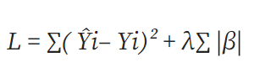
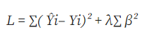
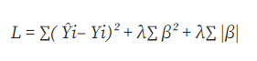
More on L1 and L2 Regularization
Lasso (L1)
Can shrink coefficients to zero so can be used for feature selection
Reduces overfitting by eliminating features
Ridge Regression (L2)
Does not shrink coefficients all the way to 0
Reduces impact of features that are not important predictors
Elastic Net (hybrid)
Combines feature elimination and feature reduction to improve model’s predictions

Slide 5
Python sklearn Implementation for Logistic Regression
Create an instance of the classifier (logistic regression)
Fit the model to the training data
LogisticRegression(penalty= ‘ ‘, solver = ‘ ‘, C= , l1_ratio = )
penalty
None – no regularization
l1 – Lasso
l2 – Ridge Regression (default)
elasticnet – Elastic Net
solver
liblinear (l1 and l2 regularization)
saga (None, l1, l2, elasticnet)
C – smaller produces stronger regularization (default = 1)
l1_ratio – required for elasticnet

Slide 6
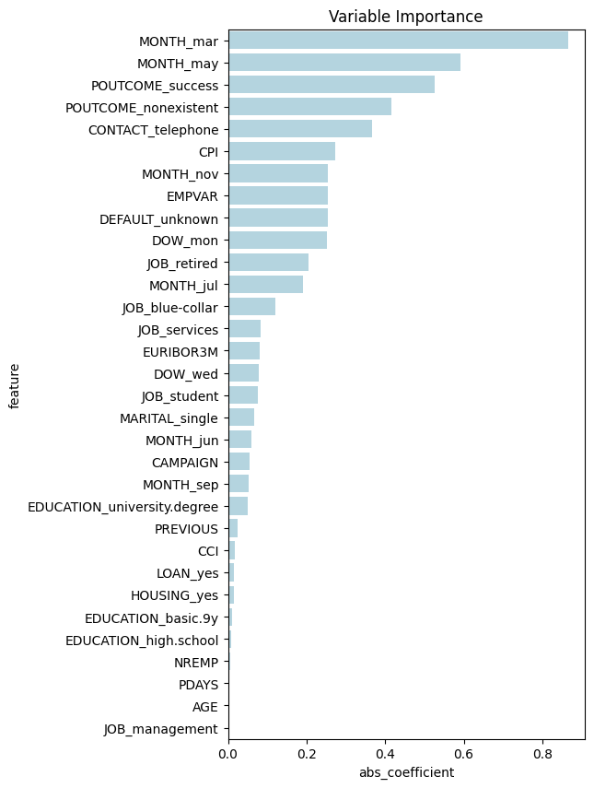
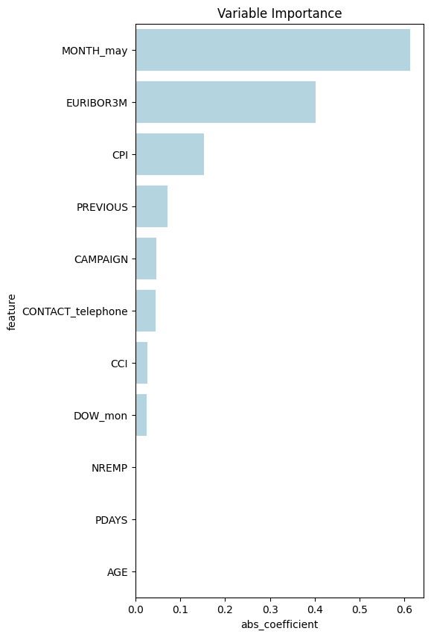
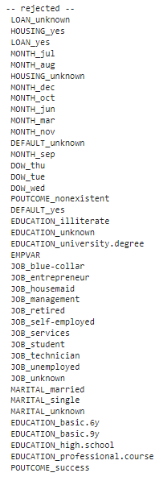
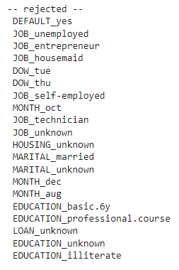
Effect of Changing C with Lasso

Slide 7
Model Comparison
 | Accuracy (Train) | Precision (Train) | Recall (Train) | AUC (Train) | Accuracy (Test) | Precision (Test) | Recall (Test) | AUC (Test)
Full | 0.9010 | 0.6761 | 0.2150 | 0.7916 | 0.8990 | 0.6987 | 0.2195 | 0.7944
Stepwise | 0.9009 | 0.6748 | 0.2150 | 0.7916 | 0.8992 | 0.7043 | 0.2188 | 0.7946
L1 (0.1) | 0.9008 | 0.6809 | 0.2078 | 0.7912 | 0.8983 | 0.6988 | 0.2083 | 0.7944
L1 (0.01) | 0.9000 | 0.6836 | 0.1923 | 0.7782 | 0.8983 | 0.7128 | 0.1985 | 0.7842
L2 | 0.9001 | 0.6968 | 0.1889 | 0.7790 | 0.8984 | 0.8280 | 0.1914 | 0.7786
Elastic Net | 0.8980 | 0.6290 | 0.2063 | 0.7164 | 0.8965 | 0.6594 | 0.1232 | 0.7205

